Slide 1
Employee Data Analysis using Excel
STUDENT NAME: JANANI SELVARAJ
REGISTER NO: 122202019
DEPARTMENT:B COM (CORPORATE SECRETARYSHIP)
COLLEGE: ANNA ADHARSH COLLEGE FOR WOMEN,ANNANAGAR –CHENNAI-600040

Slide 2
Employee Performance Analysis using Excel

Slide 3


AGENDA
Problem Statement
Project Overview
End Users
Our Solution and Proposition
Dataset Description
Modelling Approach
Results and Discussion
Conclusion
3/21/2024 Annual Review

Slide 4

PROBLEM STATEMENT
Our organization is experiencing inconsistent employee performance, impacting productivity and team morale. Current performance evaluation methods are ineffective and lack standardization. We need to implement a structured performance analysis system to address these issues and improve overall efficiency.

Slide 5

PROJECT OVERVIEW
The project aims to implement a standardized performance analysis system to enhance how employee performance is assessed and managed. By reviewing existing evaluation methods and developing consistent criteria, the project will introduce tools for effective data collection and feedback. This approach will ensure fairer evaluations, boost productivity, and better align individual performance with organizational goals, ultimately increasing overall employee satisfaction and efficiency.

Slide 6


WHO ARE THE END USERS?
The end users of a data analytics course typically include a diverse range of professionals and learners. Data analysts and scientists, who work directly with data to extract insights and apply advanced computational methods, are primary users. Business analysts and decision-makers, such as managers and executives, also benefit from understanding data analytics as it informs strategic planning and performance evaluation. Additionally, researchers in both academic and industry settings use data analytics to explore trends and phenomena. Engineers and developers integrating data analytics into software systems are another key group. Lastly, students pursuing a career in data analytics or seeking to enhance their skill sets are significant users of such courses. The content of a data analytics course is often tailored to meet the varying needs and technical proficiency levels of these different groups.

Slide 7

OUR SOLUTION AND ITS VALUE PROPOSITION
CONDITIONAL FORMATTING-MISSING
FILTER-REMOVE
FORMULA-PERFOMMANCE
PIVOT-SUMMARY
GRAPH-DATA VISUALIZATION

Slide 8
Dataset Description
EMPLOYEE DATASET-KAGGELE
26 FEATURES
9 FEATURES
EMPLOYEE ID NUMERICALS
NAME TXT
EMP TYPE
PERFOMMANCE LEVEL
GENDER-MALE/FEMALE
EMPLOYEE RATING-NUMERICALS

Slide 9

THE "WOW" IN OUR SOLUTION
PERFOMMANCE LEVEL=IFS(Z8>=5,”VERY HIGH”,Z8>=4,”HIGH”,Z8>=3”MED”,TRUE,”LOW”)
3/21/2024 Annual Review
9

Slide 10
MODELLING
DATA COLLECTION
KAGGLE-EMPLOYEE DATA
FEATURE COLLECTION
EMPLOYEE PERFOMMANCE RATING
EMPLOYEE CATEGORIZE
DATA CLEANING
MISSING VALUES
MISSING FILTER
PERFOMMANCE LEVEL
PIVOT TABLE
SLICER
GRAPHS
10

Slide 11
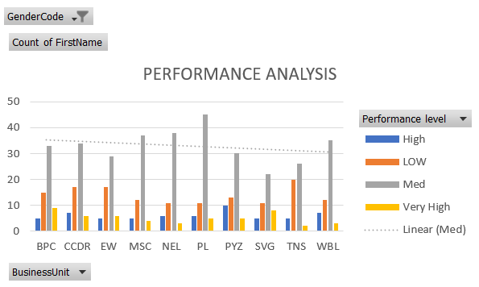
RESULTS
EMPLOYEES PERFOMMANCE LEVEL
11

Slide 12
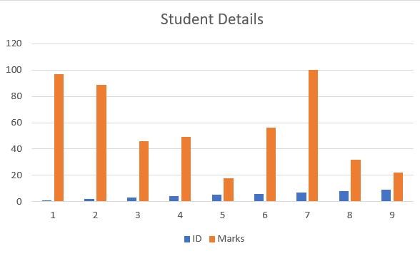
RESULTS
STUDENT PERFOMANCE
12

Slide 13
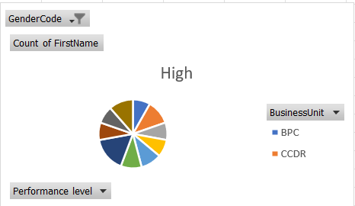
RESULTS
EMPLOYEES PERFOMANCE ON HIGH LEVEL

Slide 14
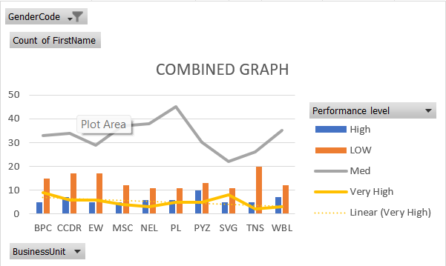
RESULTS
EMPLOYEES PERFOMANCE COMBINED GRAPH

Slide 15
Conclusion
In conclusion, a data analytics course serves a wide array of end users, each with unique needs and objectives. Whether they are data professionals, business leaders, researchers, engineers, or students, the course content must be thoughtfully designed to equip them with the necessary skills to analyze data effectively and make informed decisions. By catering to the diverse requirements of these end users, a data analytics course can significantly enhance their ability to leverage data for problem-solving and strategic growth.

